Slide 1


Leading AI Adoption: A Strategic Guide
This presentation outlines the critical leadership skills and strategies for successfully integrating AI into your organization.
by Akshay Damodar

Slide 2
Understanding AI's Potential Impact
Transformative Technology
Disruptive Forces
AI can revolutionize business processes, enhance customer experiences, and create new revenue streams.
AI is also reshaping industries, creating new opportunities and challenges for businesses to adapt.

Slide 3

Traits of Effective AI Leadership
1
Visionary
2
Strategic
Articulating a clear and compelling vision for AI adoption within the organization.
Aligning AI initiatives with business goals and ensuring they drive value.
3
Data-Driven
4
Collaborative
Prioritizing data quality and analytics to inform AI decisions and optimize results.
Fostering a culture of collaboration across teams and departments.

Slide 4
Developing a Clear AI Vision
Define Goals
1
Set clear objectives for AI adoption, specifying its role in achieving business outcomes.
Identify Opportunities
2
Analyze potential areas where AI can generate significant value, improve efficiency, or unlock new possibilities.
Develop Roadmap
3
Create a detailed roadmap outlining the implementation process, timelines, and key milestones.

Slide 5




Aligning AI with Strategic Goals
Alignment
Measurable Outcomes
Ensuring that AI initiatives are aligned with the organization's strategic priorities.
Defining key performance indicators (KPIs) to measure the impact and success of AI projects.
Data Integration
Building robust data infrastructure and ensuring data quality for AI model training and deployment.

Slide 6

Fostering Innovation and Adaptability
Experimentation
Continuous Learning
Encouraging a culture of experimentation and rapid prototyping to test and learn from AI solutions.
Staying updated on advancements in AI technology and adopting best practices for successful implementation.
Agile Approach
Embracing an agile methodology to adapt AI projects based on feedback and evolving business needs.

Slide 7



Leveraging Data and Predictive Analytics
Data Strategy
1
Developing a comprehensive data strategy that prioritizes data quality and accessibility for AI.
Predictive Modeling
2
Utilizing predictive analytics to identify trends, forecast outcomes, and support informed decision-making.
Actionable Insights
3
Converting data insights into actionable steps to optimize business processes and improve outcomes.

Slide 8
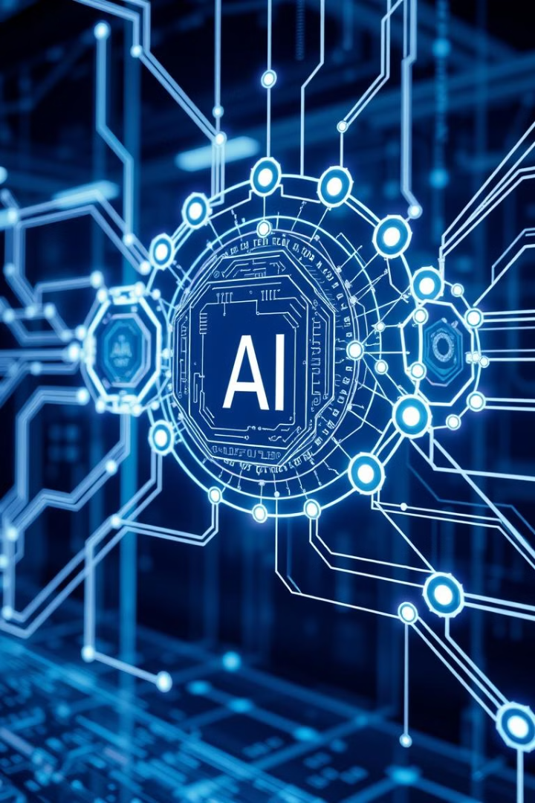



Integrating AI into Operations
Workflow Optimization
Automating repetitive tasks and processes to increase efficiency and free up human resources for strategic work.
Real-time Insights
Integrating AI into existing systems to provide real-time insights and support better decision-making.
Continuous Improvement
Monitoring and evaluating AI performance to identify areas for improvement and optimize its impact.

Slide 9

Ethical Considerations and Responsible AI
1
2
Transparency
Fairness
Ensuring transparency and accountability in AI decision-making.
Avoiding bias and promoting fairness in AI algorithms and outputs.
3
Privacy
Protecting user data and ensuring compliance with privacy regulations.

Slide 10



Building an AI-Ready Workforce

